Slide 1
Project Review
on
A Deep Learning Approach for Papilledema Detection in Retinal Fundus Images
By VENKADESAN M

Slide 2
Flow Of Presentation:
Introduction
Motivation
Problem statement
Objectives of the work
Literature Survey
Block diagram
Realistic constraints
Methodology
Dataset
Result
Reference

Slide 3
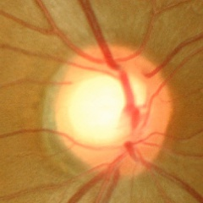
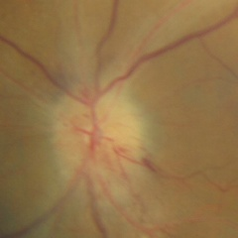
INTRODUCTION:
Papilledema: Papilledema, a swelling of the optic nerve head caused by increased intracranial pressure, is a critical condition that can lead to vision loss or other severe complications if not promptly diagnosed. The traditional diagnosis of papilledema relies on expert ophthalmologists analyzing fundus images, which can be subjective, time-consuming, and prone to inter-observer variability.
Importance of Detection: Early identification of papilledema is vital for timely treatment and prevention of complications.
Fundus Imaging: Non-invasive retinal imaging is key for detecting optic disc abnormalities
like papilledema.
Normal Papilledema

Slide 4
MOTIVATION:
Papilledema is the swelling of the optic disc due to increased intracranial pressure, often linked to severe neurological conditions. Early detection is crucial to prevent vision loss and life-threatening complications. However, manual diagnosis is time-consuming, subjective, and requires expert ophthalmologists.
Deep learning, especially convolutional neural networks (CNNs), can automate papilledema detection with high accuracy. AI models can analyze retinal fundus images, identifying subtle abnormalities that might be missed by humans. This project aims to develop an AI-based detection system to improve diagnostic speed and precision. By integrating deep learning into healthcare, we enhance accessibility, reduce human error, and enable early intervention.

Slide 5
PROBLEM STATEMENT:
To develop and evaluate a deep learning methodology for the automated identification of papilledema in fundus images, in order to enhance the diagnostic accuracy.
OBJECTIVES OF THE WORK:
Employ preprocessing methods for fundus images to boost the quality of input data for deep learning models.
To identify and select an appropriate deep learning architecture that can effectively learn and distinguish features associated with papilledema from fundus images
To train the selected deep learning model using a labeled dataset of fundus images and evaluate its performance through validation techniques.
To assess the model's performance using metrics such as accuracy, sensitivity, specificity, and AUC-ROC

Slide 6
LITERATURE SURVEY:
 | TITLE AND JOURNAL | AUTHORS | INFERENCE
1 | Fully automated diagnosis of papilledema through robust extraction of vascular patterns and ocular pathology from fundus photographs ©2017 Optical Society of America | Khush Naseeb Fatima, Taimur hassan, M. Usman akram, Mahmood Akhtar,and Wasi Haider Butt | The system automates papilledema detection from fundus images with accuracy using feature extraction and SVM classification.
2 | Papilledema Detection in Fundus Images Using Hybrid Feature Set IEEE Xplore | Khush Naseeb Fatima, M. Usman Akram Dr. Shafaat A. Bazaz | The proposed automated system using features and an SVM classifier achieves high accuracy in detecting papilledema, showing promise for future applications and further feature exploration.
3 | Assessment of Papilledema Using Fundus Images IEEE Xplore | Kamran Yousaf , Muhammad Usman Akram, Usman Ali and Shahzad Amin Sheikh | The proposed SVM-RBF classifier offers high accuracy in papilledema detection with minimal human involvement, making it suitable for automated use in clinical settings.

Slide 7
 | TITLE AND JOURNAL | AUTHORS | INFERENCE
4 | An evaluation of AI-based methods for papilledema detection in retinal fundus images Journal of the European Alliance of Medical and Biological Engineering and Science (EAMBES). | Ahmed M. Salaheldin , Manal Abdel Wahed , Manar Talaat , Neven Saleh | The paper evaluates AI-based methods for detecting papilledema in retinal fundus images ,presenting highly accurate deep learning models (multi-path CNN and LSTM) that leverage spatial and temporal features to improve diagnosis.
5 | Decision Support System for Detection of Papilledema through Fundus Retinal Images Springer Science+Business Media New York , 2017 | Shahzad Akbar , Muhammad Usman Akram, Muhammad Sharif and Anam Tariq and Ubaid ullah Yasin | This study presents an automated system to detect papilledema. It uses fundus images and extracts features. A Support Vector Machine (SVM) classifies the images.
6 | The use of artificial intelligence in detecting papilledema from fundus photographs Taiwan Journal of Ophthalmology. | Lazuardiah Anandi, Brigitta Marcia Budihardja, Erika Anggraini, Rona Ali Badjrai, Syntia Nusanti | AI models like Deep Learning Systems (DLS) achieve high sensitivity, specificity, and accuracy in detecting and grading papilledema, matching expert-level performance.

Slide 8
BLOCK DIAGRAM:
Data Collection and Preprocessing
Model Selection
Model Training and Optimization
Validation and Testing

Slide 9
SOFTWARE DETAILS:
IDE Editors
Jupyter Notebook
Python Environment
Anaconda
Visualization Tools
Matplotlib

Slide 10
METHODOLOGY:
:
Inception V3 + Spatial Attention + Dropout
Model Architecture:
Inception V3
Spatial Attention Block
Global Average Pooling
Dropout 1
Fully Connected Layer 1
Fully Connected Layer 2
Dropout 2
Output layer
Weights obtained from pretrained on imagenet are used.
Trained on last 30 layers and other layers freezed.
2 sets of fully connected layers to increase parameters.
2 sets of dropout layers to prevent overfitting.

Slide 11
Data Preparation:
Directory
Dataframe
Upsample (623 per class)
Train split
Test - val split
Augmentation
Validation
Testing
Dataset was upsampled and augmented to majority class (623 images).
80% dataset was used for training wherein 20% of it was used for validation.
Train images were heavily augmented to induce variation on upsampled data.
20% of dataset was evaluation without augmentation.
Training:
78s to 300s per epoch with total of 40 epochs.
Reccallbacks.

Slide 12
REALISTIC CONSTRAINTS:
Overfitting: Limited data may cause the Inception V3 model to overfit, reducing its generalization to unseen data.
Limited Data Availability: The dataset with 779 images may not be sufficient to train a complex deep learning model effectively.
Imbalanced Data: Unequal distribution among classes (normal, pseudo-papilledema, papilledema) can lead to biased predictions.
Testing Challenges: With limited data, setting aside a significant portion for testing reduces the training data further, making evaluation harder.
High Trainable Parameters: Inception V3 has a large number of trainable parameters, which requires adapting the dataset to avoid underfitting or overfitting.
Hyperparameter Tuning: Finding the optimal hyperparameters (learning rate, batch size, etc.) will be time-intensive and challenging with limited data

Slide 13
DATA SET:
Identification of pseudo papilledema
Normal - 779 (images)
Papilledema -295 (images)
Pseudo papilledema -295 (images)

Slide 14
RESULT:
There were 22 errors in 374 tests for an accuracy of 94.12%
Recall (Sensitivity) for each class:
Normal: 0.9435
Papilledema: 0.9360
Pseudopapilledema: 0.9440
Specificity for each class:
Normal: 0.9680
Papilledema: 0.9880
Pseudopapilledema: 0.9558
Overall Precision: 0.9419
Overall Recall: 0.9412
Overall F1-score: 0.9413
Overall Specificity: 0.9706

Slide 15
Classification Report:
precision recall f1-score support
Normal 0.9360 0.9435 0.9398 124
Papilledema 0.9750 0.9360 0.9551 125
Pseudopapilledema 0.9147 0.9440 0.9291 125
accuracy 0.9412 374
macro avg 0.9419 0.9412 0.9413 374
weighted avg 0.9419 0.9412 0.9413 374

Slide 16
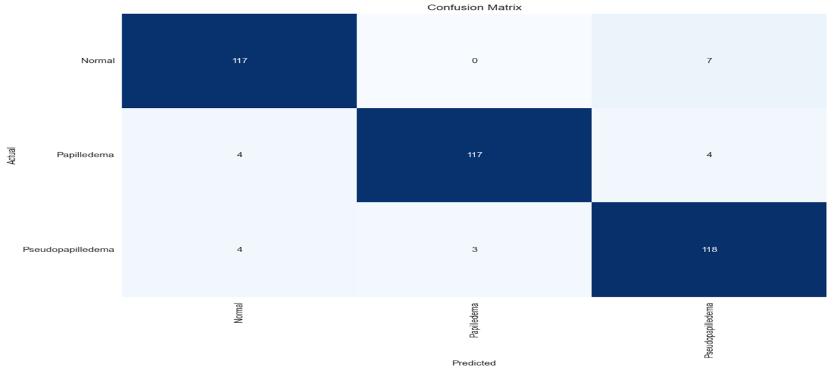
CONFUSION MATRIX:

Slide 17
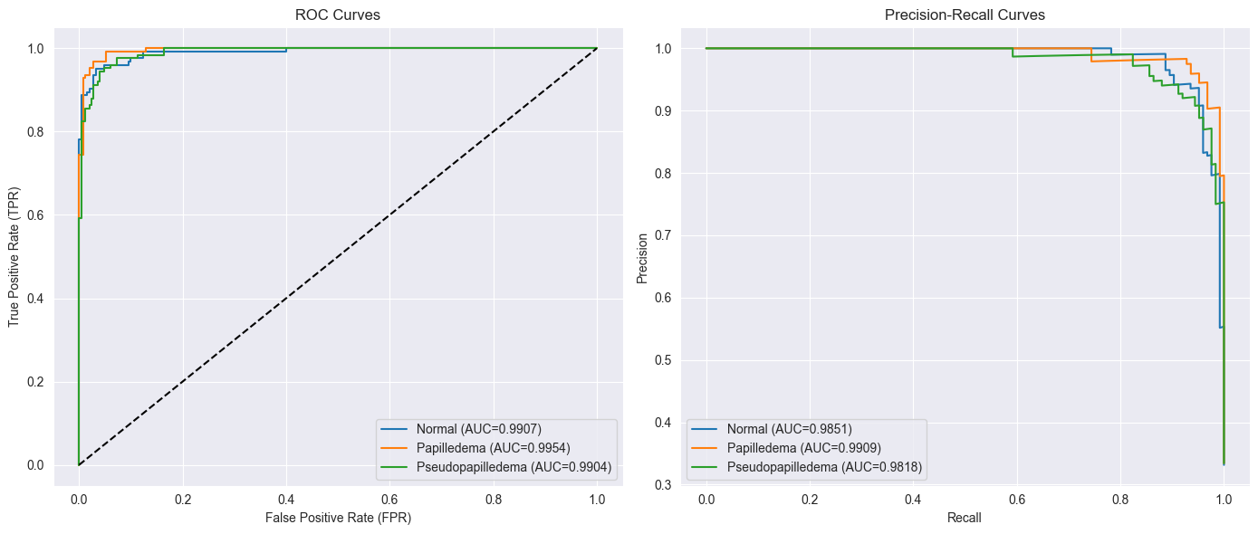
ROC and Precision Recall Curve:
Macro-Averaged ROC AUC: 0.9922
Macro-Averaged PR AUC: 0.9859

Slide 18
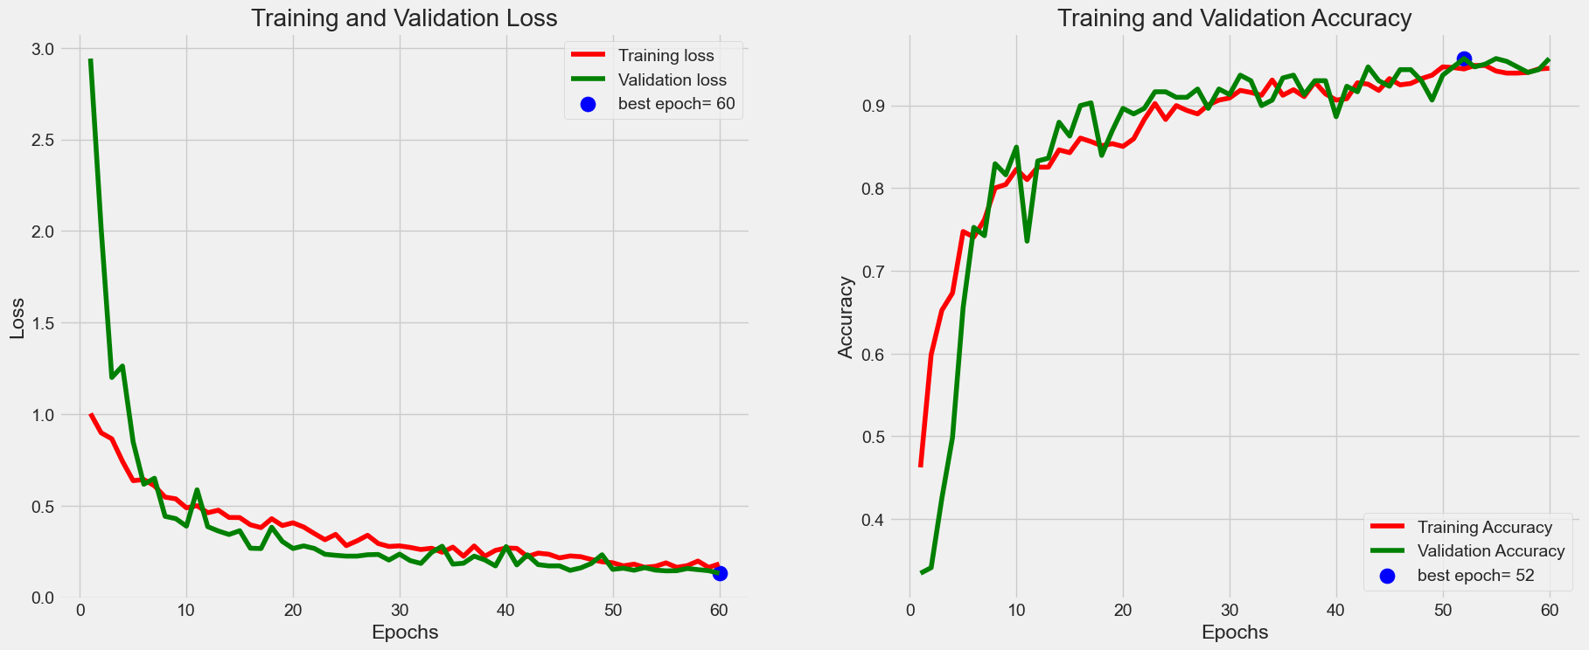
Training vs Validation Graph:

Slide 19
COMPARISON:
Method | No of Classes | Epoch | Optimization | Learning Rate | Accuracy (%) | Sensitivity (%) | Specificity (%) | Precision (%) | F1-score | AUC
Efficient Net | 3 | 40 | Adam | 0.0001 | 90.5 | 91.6 | 96 | 87.2 | 0.889 | 0.8934
InceptionV3 | 3 | 40 | Adam | 0.0001 | 78.1 | 82.92 | 90.71 | 76.20 | 0.7716 | 0.7652
InceptionV3+ Spatial attention | 3 | 40 | Adam | 0.0001 | 87.59 | 88.48 | 94.73 | 83.81 | 0.8556 | 0.9787
Inception V3+Spatial attention+ Dropout | 3 | 40 | Adam | 0.0001 | 94.12 | 94.12 | 97.06 | 94.19 | 0.9413 | 0.9922

Slide 20
REFERENCES
K. Fatima, T. Hassan, M. Akram, M. Akhtar, and W. Butt, "Fully automated diagnosis of papilledema through robust extraction of vascular patterns and ocular pathology from fundus photographs," Biomed. Opt. Express 8, 1005-1024 (2017).
K. N. Fatima, M. U. Akram and S. A. Bazaz, "Papilledema Detection in Fundus Images Using Hybrid Feature Set," 2015 5th International Conference on IT Convergence and Security (ICITCS), Kuala Lumpur, Malaysia, 2015, pp. 1-4, doi: 10.1109/ICITCS.2015.7293007.
K. Yousaf, M. U. Akram, U. Ali and S. A. Sheikh, "Assessment of papilledema using fundus images," 2016 IEEE International Conference on Imaging Systems and Techniques (IST), Chania, Greece, 2016, pp. 476-481, doi: 10.1109/IST.2016.7738273.
Ahmed M. Salaheldin, Manal Abdel Wahed, Manar Talaat, Neven Saleh, An evaluation of AI-based methods for papilledema detection in retinal fundus images, Biomedical Signal Processing and Control, Volume 92, 2024.
Akbar S, Akram MU, Sharif M, Tariq A, Yasin UU. Decision Support System for Detection of Papilledema through Fundus Retinal Images. J Med Syst. 2017 Apr;41(4):66. doi: 10.1007/s10916-017-0712-9. Epub 2017 Mar 10. PMID: 28283997.
Anandi, Lazuardiah et al. “The use of artificial intelligence in detecting papilledema from fundus photographs.” Taiwan journal of ophthalmology vol. 13,2 184-190. 1 Jun. 2023, doi:10.4103/tjo.TJO-D-22-00178.

Slide 21
THANK YOU

